Slide 1
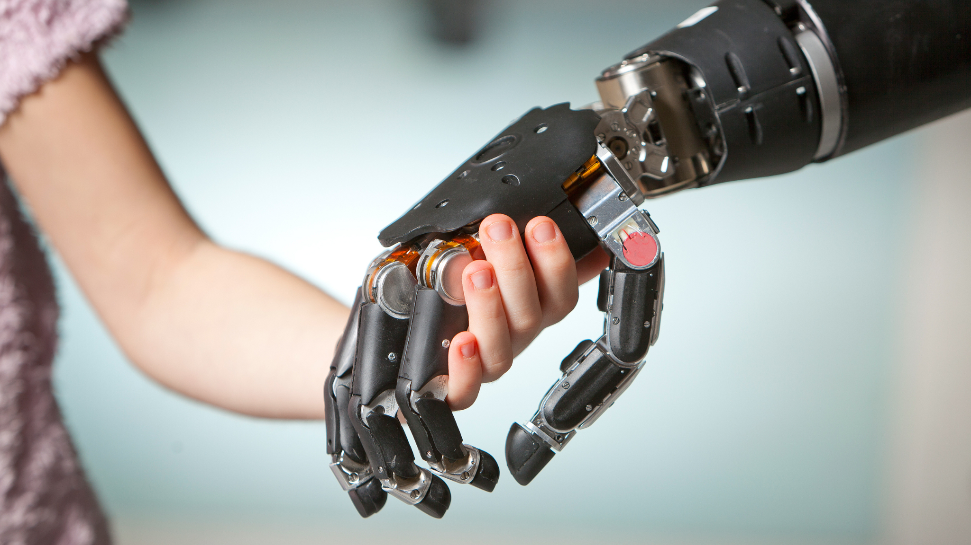
MOBOT
Revolutionizing Mobility
DWL 2022 Hackathon
Presented by QWERTY

Slide 2
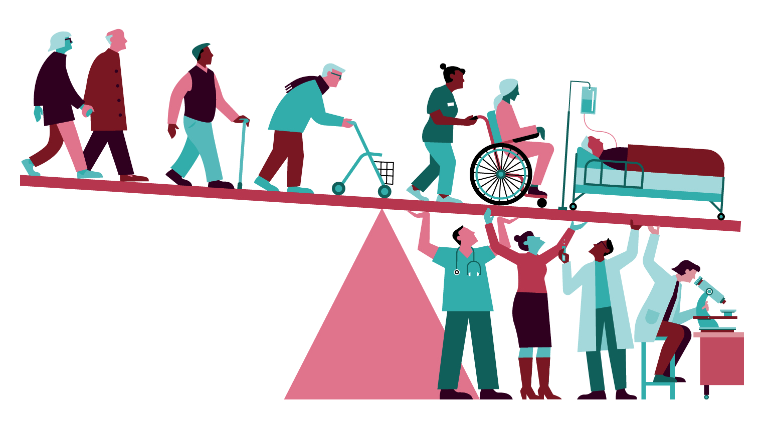
INTRODUCTION
Singapore's population is ageing rapidly, with the proportion of citizens aged 65 and above increasing to 18.4 per cent in 2022. To develop a public-health response to ageing, we must consider the individual and environmental approaches that ameliorate the losses associated with older age.

Slide 3
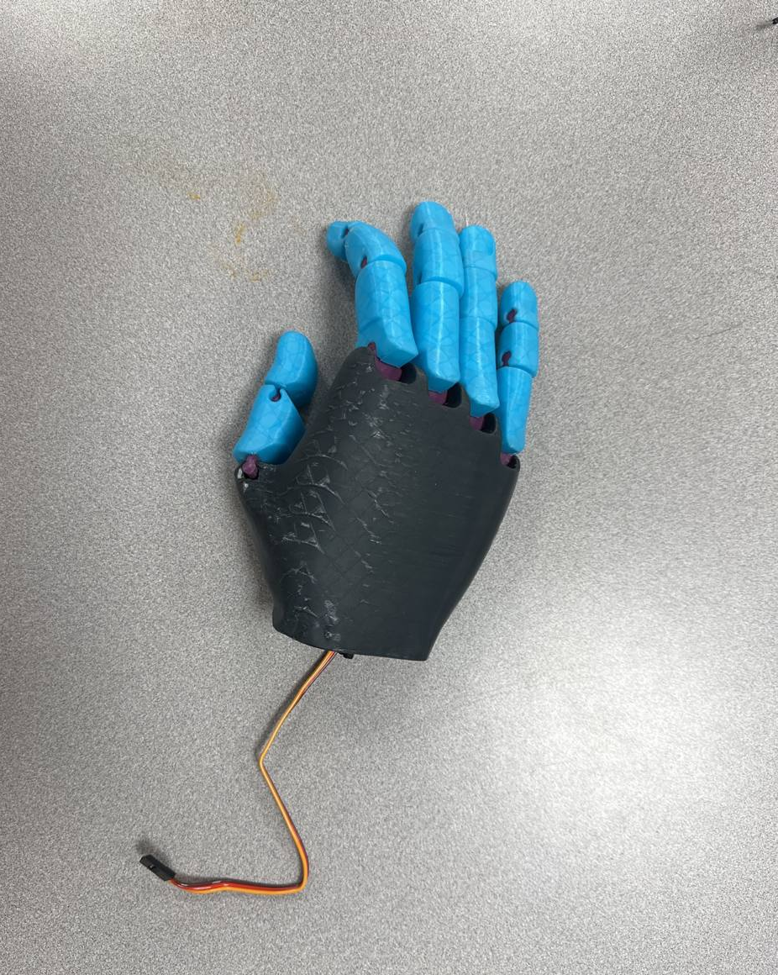
SMART NATION PROPOSAL
Prosthesis to assist those who experience mobility issues and face general frailty. Our solution is equipped with AI enabled vision and voice activation systems, for mobility assistance.

Slide 4

CAPABILITIES
The Prosthesis in our prototype is a direct replacement of a hand. Our main purpose was to create a Prosthesis hand, capable of grabbing objects with built in features to assist those with mobility issues. Our hand can grab a variety of objects with varying degrees of force, with AI enabled features.

Slide 5
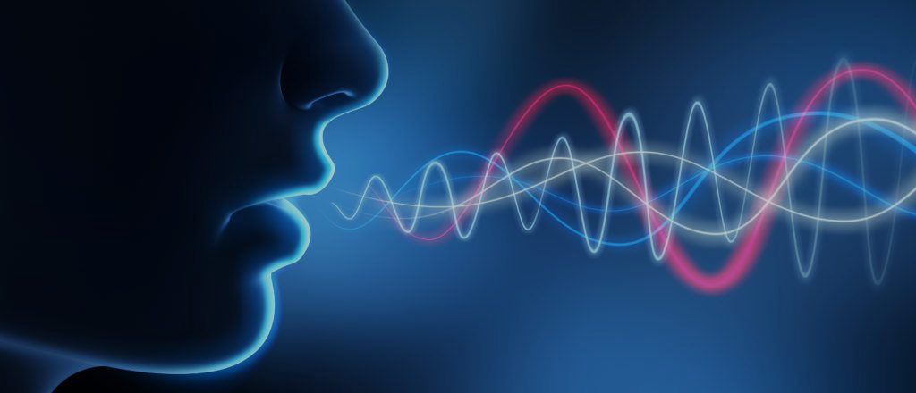
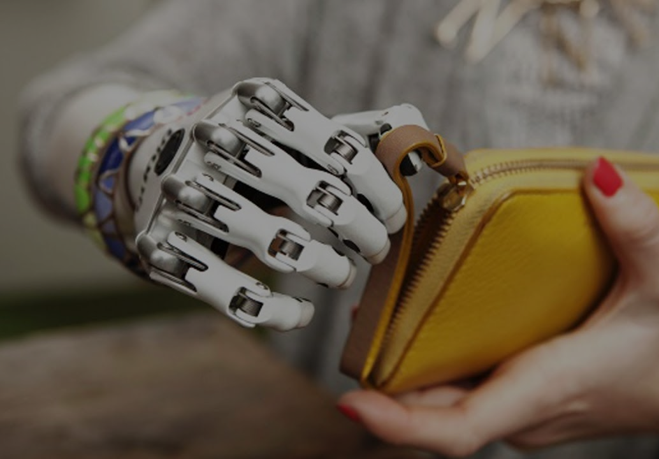
VOICE ACTIVATION
COMPUTER VISION
FUNCTIONALITY
BRAINWAVE ACTIVATION
TRIGGER ACTION
User calls an object name that has been trained in the program. Their command is processed through voice recognition AI.
Camera streams live feed to the Jetson Nano. AI implements object detection and classifies the object detected.
Using electroencephalography waves to classify blinking as means of communication.
A signal is sent from the Jetson Nano to the Arduino board. Triggering the Servos to rotate to a specified angle.

Slide 6
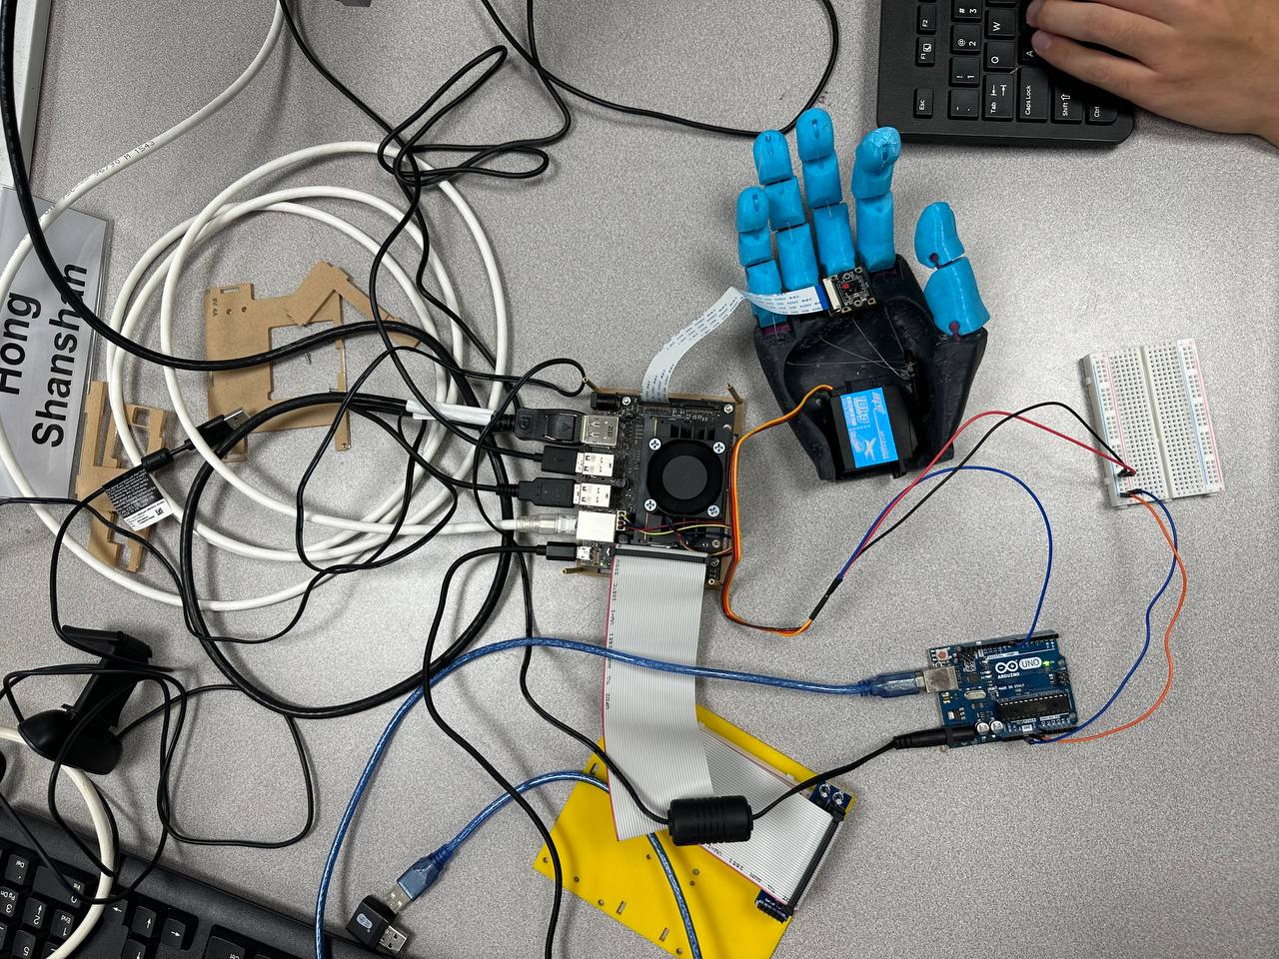
HARDWARE INVOLVED
JETSON NANO
ARDUINO
TAILORED PROSTHESIS
MUSE 2
Equipped with a Graphic Processing Unit to enable instantaneous object detection on camera feed.
A microcontroller which directs the digital components from the signals received from the Jetson Nano.
Custom generated 3D hand cast made of PLA 11. Saturday build, water resistant and cost effective.
Multi-sensor device that provides real-time feedback on brain activity, heart rate, breathing, and body movements

Slide 7
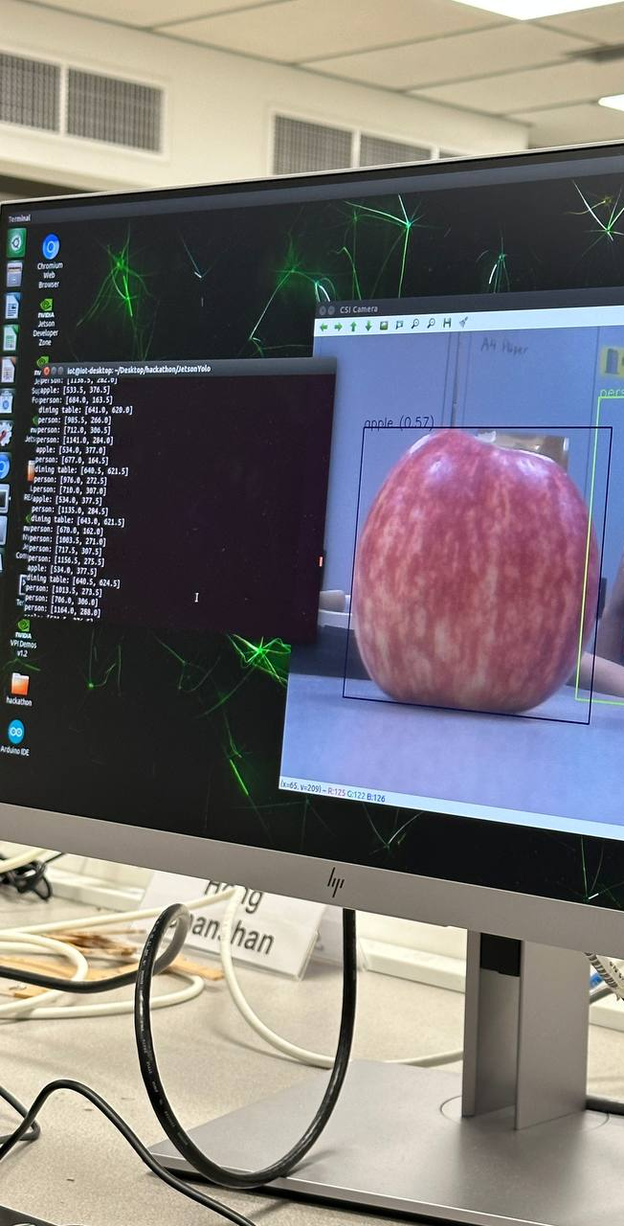
VOICE
VISION
AI IMPLEMENTATION
We use AI for voice recognition, identifying and comparing the text picked up with the data trained. The data returned is compared with the vision system to establish the next course of action.
Live camera feed undergo an object recognition algorithm and distance estimation. The visual information is compared to the voice data fed to the hand as commands.

Slide 8

THANK YOU

